Slide 1
Security
Professor K. Yotov
Slides by Professor G. Sandoval
Some slides derived from : Tanenbaum/Bo, and Brendan Dolan-Gavitt
Thanks !!

Slide 2

Security
The Security Environment
OS Security
Controlling Access to Resources
Formal Models of Secure Systems
Basics of Cryptography
Authentication
Software Security

Slide 3
Computer Security
Security is a big field, encompassing:
Application security
Network security
Authentication
Digital forensics
Cryptography
Privacy/Anonymity

Slide 4
Operating Systems Security
In this course we will only worry about security as it applies to operating systems
This is some mix of authentication, access control, and application security
Notes:
Authentication: We might have systems with multiple users, but we want to make sure that the right person is allowed to the right set of files.
Access Control: defining on a multiuser system who owns a file, who gets to modify it. Etc.
App Security: OS include features that even if the programmer messes up, we get

Slide 5
Computer Security
Generally, we talk about computer security in three broad categories:
Confidentiality – Exposure of data or preventing others from finding out information we don't want them to have
Integrity – Tampering with Data or preventing others from modifying our data without permission
Availability – Denial of Service or preventing others from denying us access to some service ()
Notes:
Availability: harder in practice to achieve. For example lock you out of your account.

Slide 6
Computer Security
Generally, we talk about computer security in three broad categories:
Confidentiality – Exposure of data or preventing others from finding out information we don't want them to have
Integrity – Tampering with Data or preventing others from modifying our data without permission
Availability – Denial of Service or preventing others from denying us access to some service ()
Notes:
Availability: harder in practice to achieve

Slide 7
Threat Modeling
It usually doesn't make sense to talk about a system being "secure" or "insecure"
Instead, we need to be more precise:
What are we trying to protect?
Who do we need to protect against? What are their capabilities?
Notes:
Example of the login with the secret key combination without the password

Slide 8
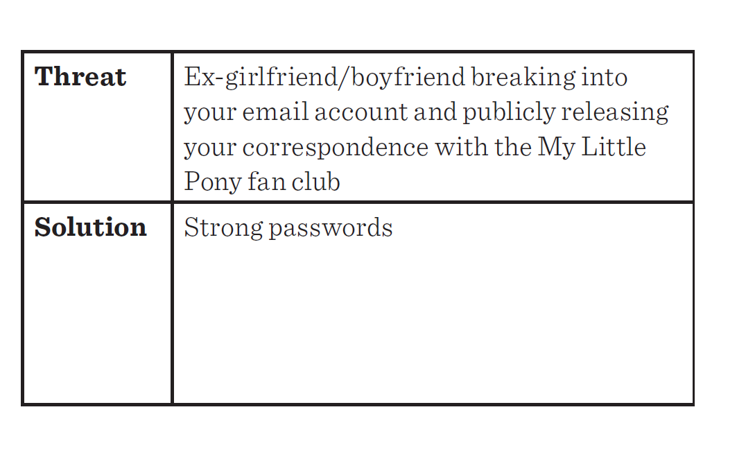
A Practical Threat Model
Source: Mickens, This World of Ours

Slide 9
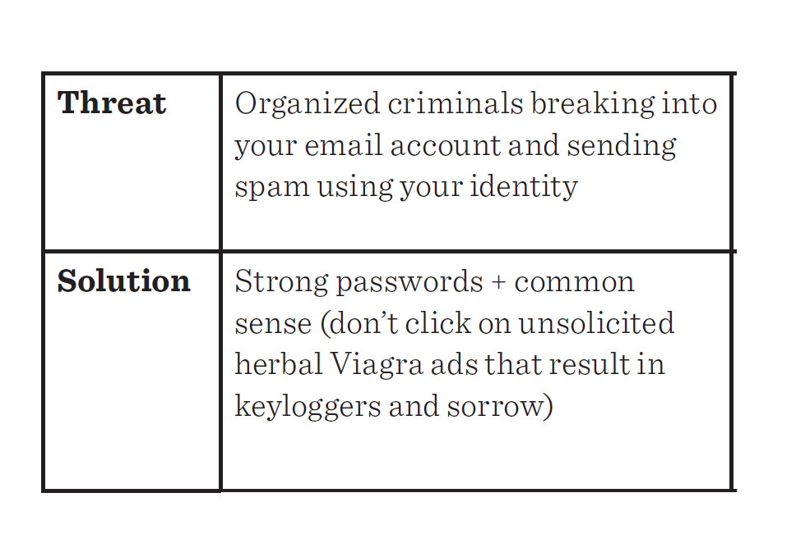
A Practical Threat Model
Source: Mickens, This World of Ours

Slide 10
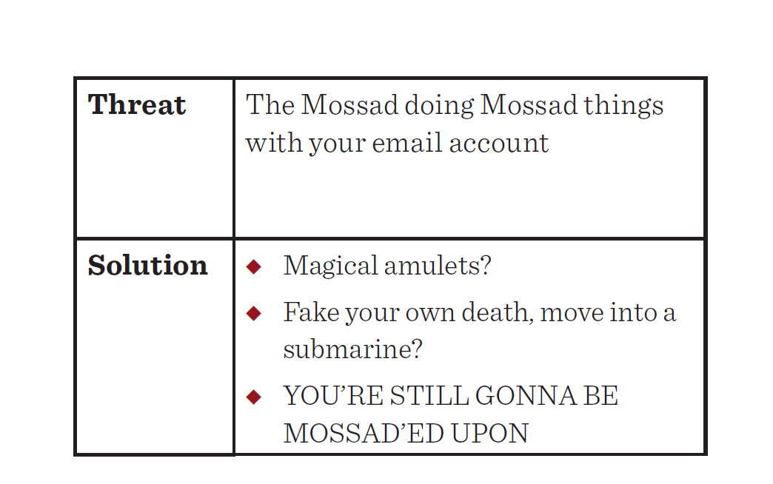
A Practical Threat Model
Source: Mickens, This World of Ours

Slide 11
Threat Modeling
Roughly, we can divide this into three steps:
System understanding
Threat categorization
Countermeasures and mitigation
Notes:
House example

Slide 12
System Understanding
To properly protect a system, you need to understand it:
Identify assets that need protecting
Look at ways the system can be used and assets can be accessed
Figure out what rights should be granted to what assets and classes of user
Identify privilege boundaries – places where a program or user changes their privilege level
Notes:
Policies
Once you log in you have privileges

Slide 13
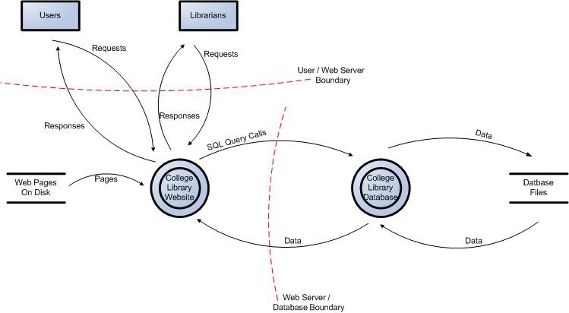
Example System Diagram
Source: OWASP
Notes:
College library

Slide 14
Threat Categorization
Look at the system from an attacker's point of view
What goals might an attacker have?
How could they achieve these goals?
May help to use a threat categorization such as STRIDE: Spoofing, Tampering, Repudiation, Information Disclosure, Denial of Service, Elevation of Privilege
Notes:
Put yourself in the shoes of the attacker
Repudiation: After the fact you didn’t do something. I didn’t hit him.
Record of the system that you logged into.
Spoofing: pretending something you are not.
Tampering: modifying data you are not supposed to

Slide 15
Mitigation
For each of the threats to some asset, come up with a plan for mitigating or nullifying the threat, for example:
Attacker might guess someone's password => enforce password complexity requirements
Attacker might snoop on network traffic => encrypt data that is sent on the network
Notes:
Credit card system. Mitigate after the fact. Rollback transaction.

Slide 16
Security
The Security Environment
OS Security
Controlling Access to Resources
Formal Models of Secure Systems
Basics of Cryptography
Authentication
Software Security

Slide 17
Trusted Computing Base
One strategy for building secure operating systems is to organize them into trusted and untrusted components
The goal is that if the trusted component performs according to its specification, then some specific set of guarantees about security must hold
A reference monitor checks all accesses between the trusted and untrusted components

Slide 18
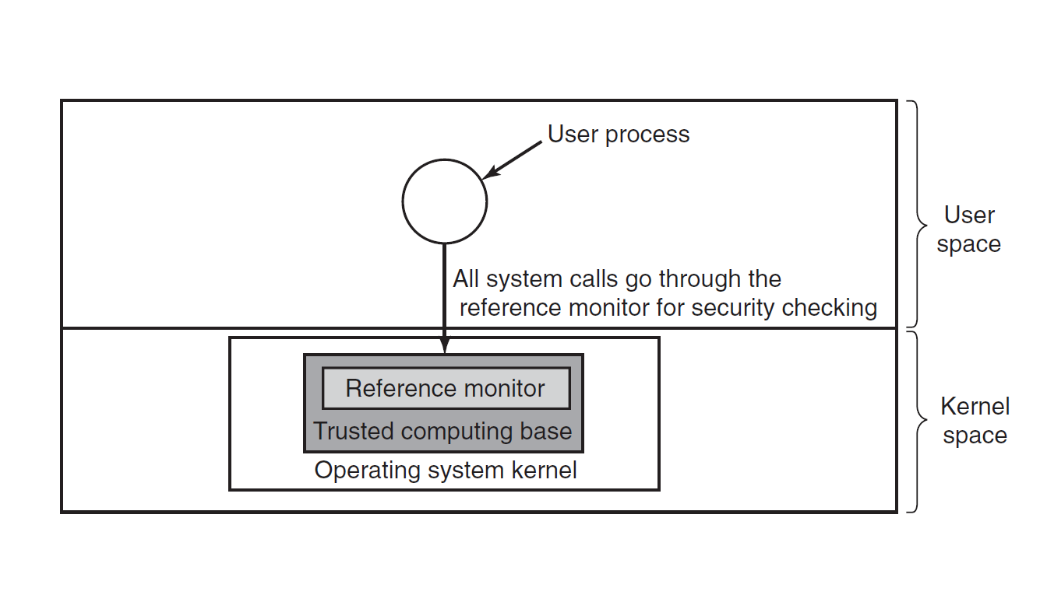

Slide 19
Aside: Bugs & Program Size
One rule of thumb is that as program size increases, the number of bugs increases as well
It's harder to reason about code the more of it there is
Therefore, if we want to be confident in our trusted computing base, we should work to minimize the amount of code in it
How big is the TCB(Trusted Computed Base) for widely-used operating systems?
Notes:
Is the CPU part of the TCB? Yes.

Slide 20
Security
The Security Environment
OS Security
Controlling Access to Resources
Formal Models of Secure Systems
Basics of Cryptography

Slide 21
Access Control: Resources
Systems tend to have resources that need to be protected
Hardware: CPUs, memory, disk drives, ...
Software: processes, files, databases, ...
We'll refer to these generally as "objects" for now

Slide 22
Protection Domain
A protection domain is a set of (object, rights) pairs
A right, in this context, means an operation that can be performed on an object
So, for example, a protection domain might correspond to a user, and the set of objects they have access to
Or, a group of users that all share the same rights

Slide 23
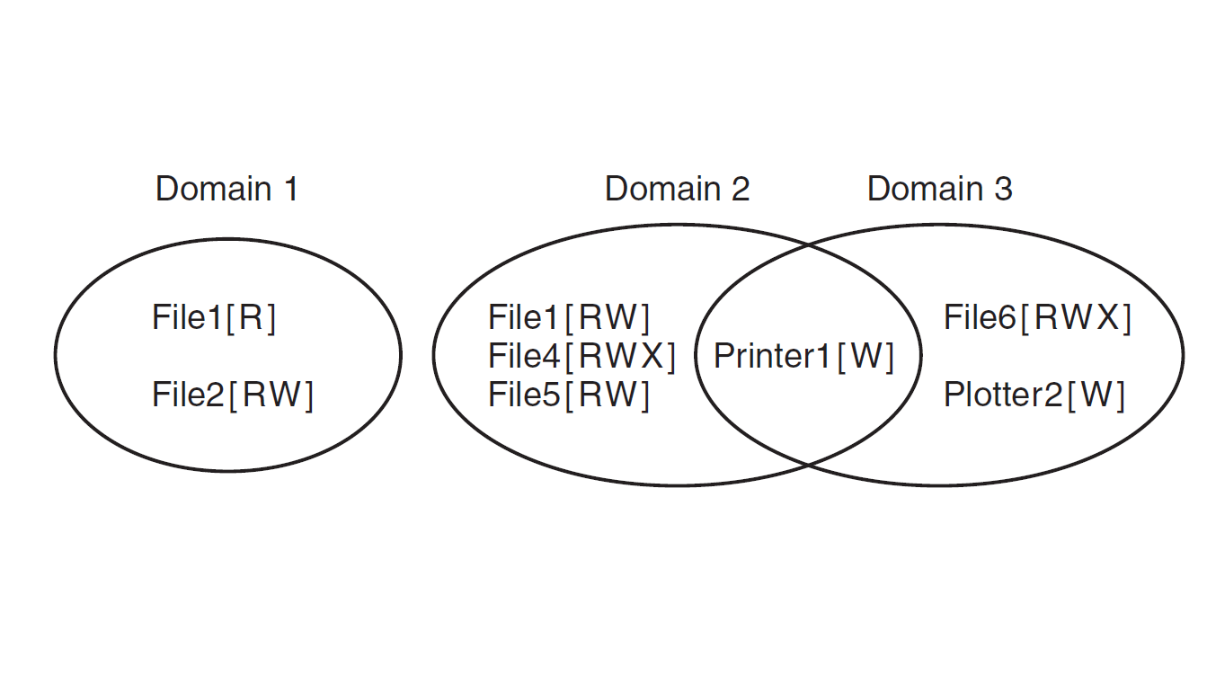
Protection Domain

Slide 24
Principle of Least Privilege
One principle for designing secure systems is principle of least privilege, also called the principle of least authority
Idea: Give the minimal set of rights to an object.
Seems obvious, but is often violated in practice

Slide 25
Processes and
Protection Domains
At any given time, a process operates in one protection domain
I.e., there is some specific set of objects that it has permission to perform some actions on
Processes can also typically switch between protection domains as they run
The rules for when and how they do this vary widely between different operating systems

Slide 26
The UNIX Protection Model
The protection domain of a process in UNIX is defined by its user id (UID) and group id (GID)
The objects are files (including special files like hardware devices)

Slide 27
The UNIX Protection Model
Each process is further divided into two halves: kernel mode and user mode
The kernel half can access a different set of objects from the user half, so the change from user to kernel is a domain switch
Executable files can also have SETUID and SETGID bits, meaning that when they are executed they will run under different permissions
Notes:
For example changing the password!
Setuid of whatever user => runs as root
Lots of bugs

Slide 28
Protection Matrix
We can describe domains using a protection matrix
Rows represent the domains
Columns represent the objects
Entries in the matrix list the allowed operations

Slide 29
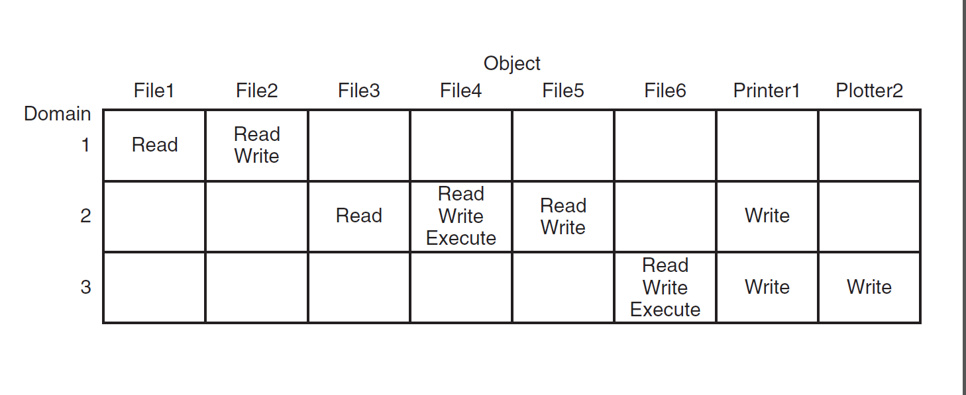
Protection Matrix
Notes:
Domain = users
How to move from one domain to another?

Slide 30
Modeling Domain Switches
We can also use the protection matrix to model a domain switch
Domains = just another object
The associated right is the ability enter the domain

Slide 31
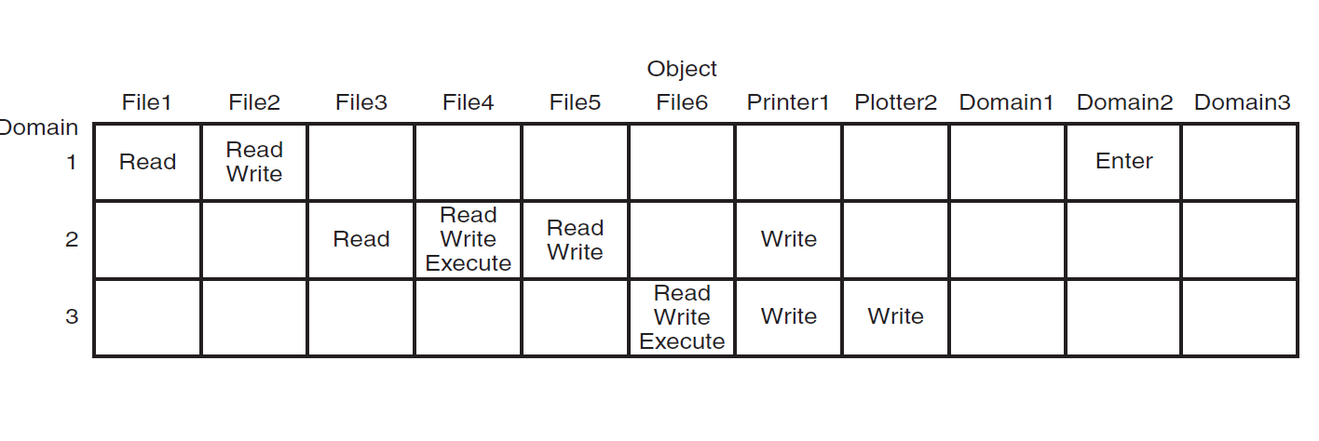
Domain Switch Matrix
Notes:
N x M. This gets really big. NO one implements this as a matrix.

Slide 32
Access Control Lists
Very few systems use a literal protection matrix to represent permissions
Protection matrix is large and sparse – wastes space
Instead, attach to each object a list of domains and the rights for each
This is an access control list (ACL)
When talking about ACLs, we often refer to domains as "subjects" or "principals"
Notes:
In practice

Slide 33
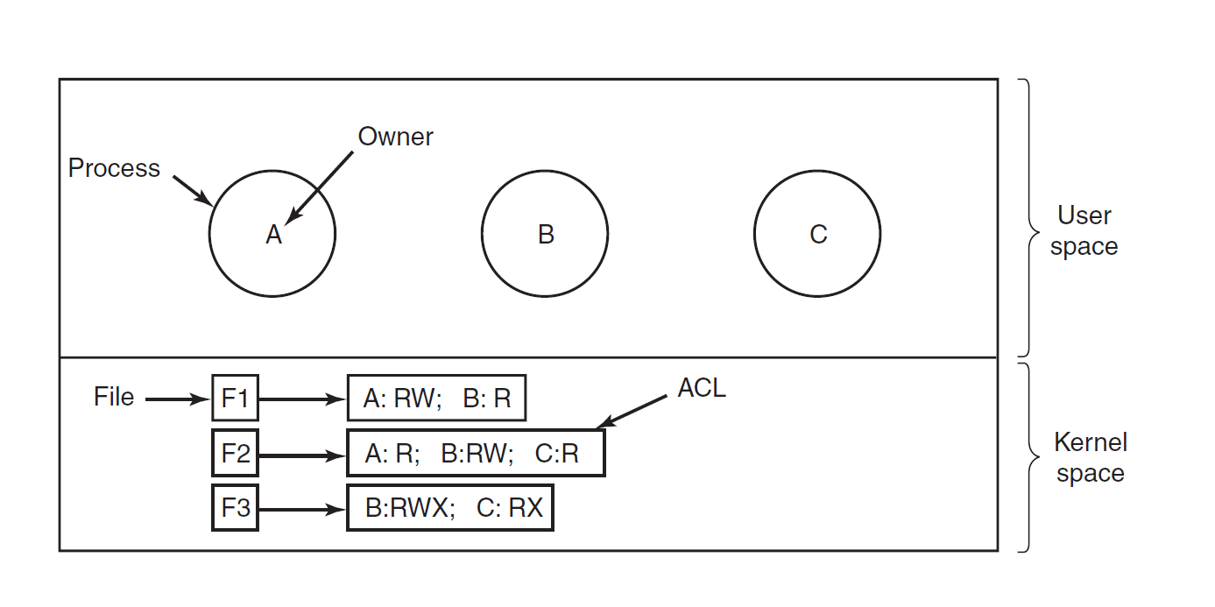
Basic ACL

Slide 34
Groups and Roles
In addition to specifying access by user, we can have groups of users
Access can then be determined by what group you're currently logged in as (what role you currently have)
Or, access can be granted if any of the groups you belong to has access (e.g., groups in UNIX)
Notes:
Groups of users: My little pony fan club
Your rights are the union of all the rights

Slide 35
Capabilities
We can also track access control by keeping, for each process, a list of objects it can access
This is called a capability list (C-List) and the individual entries are capabilities

Slide 36
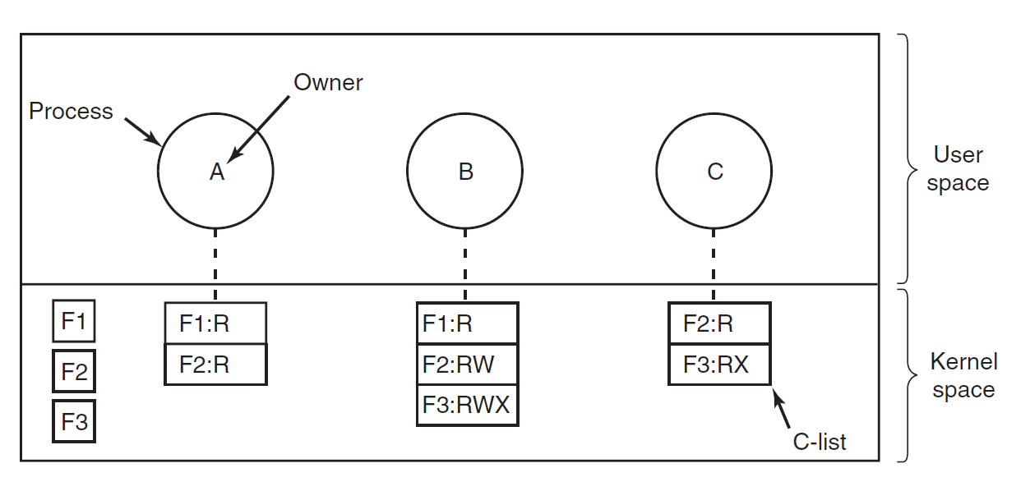
Capability Lists

Slide 37
Representing C-Lists
To be secure, the C-List should not be modifiable by the process itself
Otherwise a process could give itself arbitrary capabilities
Three general ways to enforce this:
Hardware
Capability descriptor
Cryptography

Slide 38
Hardware-Assisted Capabilities
If you have a tagged architecture, each word in memory can have a bit associated with it (a tag)
If a word is tagged, then it refers to a capability and can only be modified in kernel mode
IBM AS/400 is one example of hardware that supported this

Slide 39
Capability Descriptors
If you don't have hardware support, you can also move the C-Lists into the kernel
Now, to access an object, you refer to a descriptor and ask the kernel to carry out the operation
The descriptor is often just the index into the table of capabilities stored in the kernel
The Hydra operating system (1974) used this technique
Notes:
Drawing for the PCB

Slide 40
Cryptographic Capabilities
Cryptography provides us with a way to store a capability wherever we like (even in user space) while protecting it from modification
Suppose we have a cryptographic one-way function: f(Data, Secret) => Output (fixed length)
Where it is computationally infeasible to figure out Secret if we only have Output

Slide 41
Cryptographic Capabilities
To give a process a capability, kernel gives out ObjectId, Rights, Token where Token = f(ObjectId+Rights, Secret)
Now when the process wants to access something, it includes the capability, including the token
The kernel can now compute f(ObjectId+Rights, Secret) and compare it to the Token
If they match, we know the ObjectId and Rights have not been modified
Notes:
Secred is stored in the kernel

Slide 42
Cryptographic Capabilities
The nice thing about using cryptography in this way is that we can store the capability anywhere
In particular, capabilities can even be given out to remote machines that we don't control
This makes them ideal for distributed systems
Example: the Kerberos protocol uses capabilities this way (though it calls them tickets)
Notes:
It only matters that we can verify it. It doesn’t matter that we don’t trust
Most single signon systems use Kerberos
NYU uses a variant of it.
The crypto token is stored in your browser.
That token is presented now when you visit another NYU website, it presents the token and the other website can just check that it was granted by the NYU auth server.

Slide 43
DAC and MAC
Most OSes use a policy of discretionary access control: users get control over who has access to their files
This isn't appropriate for every scenario, though: there may be policies that mandate that some kinds of information cannot be shared
In this case we need mandatory access control

Slide 44
Security
The Security Environment
OS Security
Controlling Access to Resources
Formal Models of Secure Systems
Basics of Cryptography
Authentication
Software Security

Slide 45
Multi-Level Security
The usual way to do mandatory access control is by splitting users and information into access levels
Classic example: unclassified, secret, top secret
However, there still has to be some policy for allowing information to move between levels so work can get done

Slide 46
Bell-LaPadula
Designed to formally model the US Department of Defense security policy
Users and data are assigned security levels from low to high
Then we have the policy:
Users at a lower level cannot read information at a higher level (no read up)
Users at a higher level cannot send information to a lower level (no write down)

Slide 47
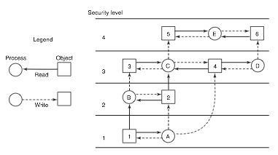
Bell-LaPadula

Slide 48
Biba
Bell-LaPadula is fine in terms of confidentiality, but does not ensure integrity
We may not want unprivileged users to modify information at higher levels
Example: military chain of command – generals can give orders to a colonel, but a colonel can't give orders to a general
The Biba model ensures integrity by inverting the Bell-LaPadula policy:
Users at a higher level cannot read information at a lower level (no read down)
Users at a lower level cannot send information to a higher level (no write up)

Slide 49
Covert Channels
Do these models actually guarantee that in practice, unauthorized information can't leak between levels?
No! It turns out there are many more ways to transfer information than the authorized channels
For example, a user at one security level could send sensitive information to a lower level by performing more or less computation
Resulting delays could be observable to lower levels, transmitting information
Notes:
SIPR net
Very hard.

Slide 50
Steganography
Even if we allow a human to inspect all data passed between levels, we can still have covert channels
The way to do this is with steganography – hiding data inside other data
Essentially, make changes that are not observable unless you know what you're looking for, and use those changes to encode information
Notes:
Barbers and tattoo on the head

Slide 51
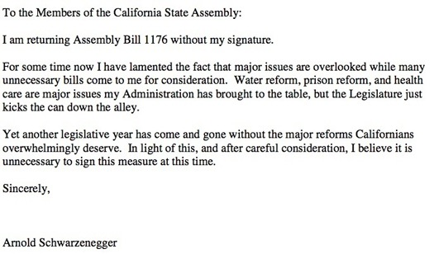
Notes:
Used steganography to hide the message

Slide 53
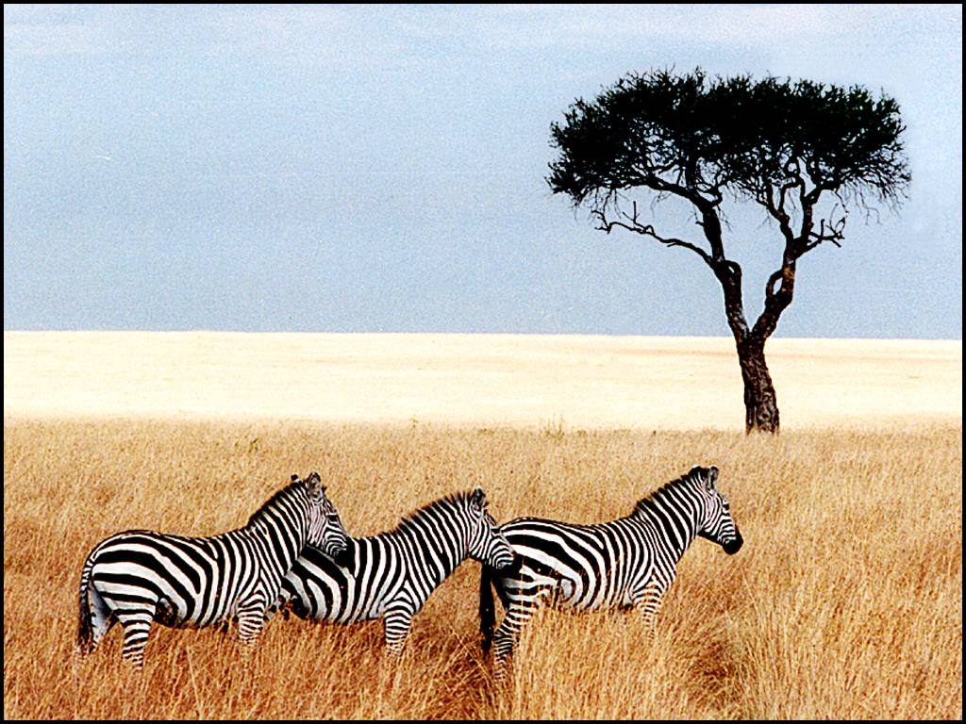

Slide 54
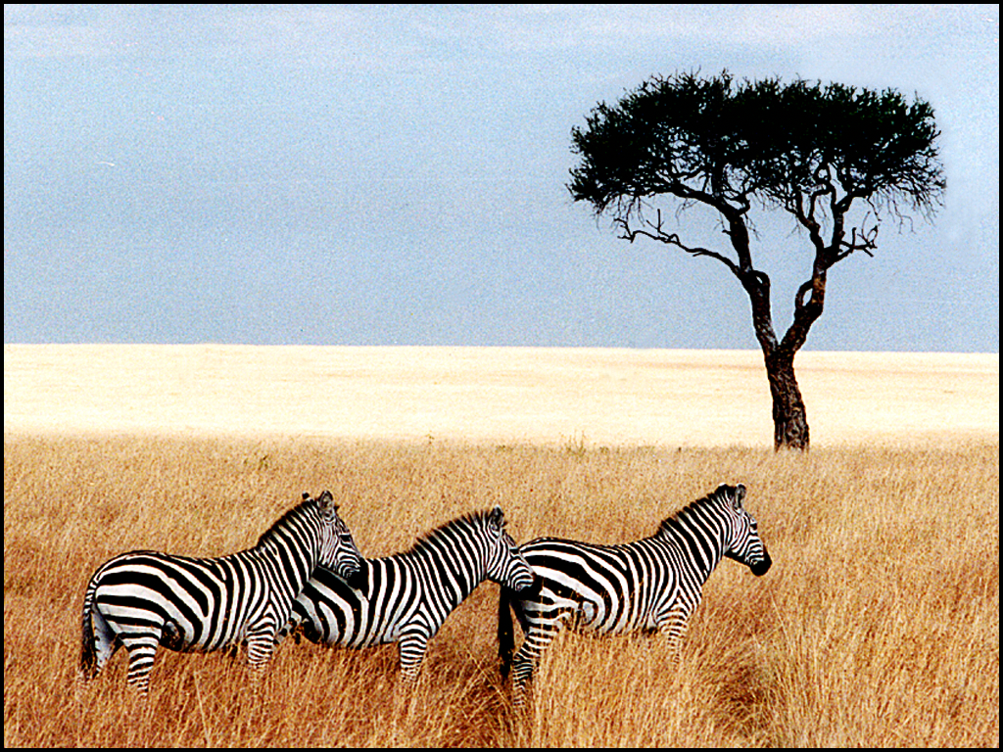
Notes:
Contains text of five plays by Shakespear. Takes 700KB

Slide 55
Steganography
How does this work? Suppose each color is represented by three bytes (red, green, blue)
Take the least significant bit of each byte and use it to store your own information
This only adds or subtracts 1 from each color value – not visually detectable
So we can now get 1 bit of secret information per byte of public information!
Notes:
1024 x 768 => 76 KB of data, so you can fit a couple of novels of text.

Slide 56
Security
The Security Environment
OS Security
Controlling Access to Resources
Formal Models of Secure Systems
Basics of Cryptography
Authentication
Software Security

Slide 57
Cryptography
Cryptography has been around a long time – at least since the Greeks, and probably earlier
But it has changed a lot since then
Particularly since World War II, many advances have been made in both codemaking and codebreaking
(Right now, the codemakers are winning!)

Slide 58
Kerckhoffs's Principle
Basic principle: it should not matter if the cryptographic algorithm is known by everyone
The only secret information should be a secret key chosen by the participants
Less information to keep secret
If the key is revealed, we can just change it
Restated by Claude Shannon: "The enemy knows the system"

Slide 59
Secret Key Cryptography
Two parties who want to communicate agree on a secret key shared between them
Then they use encryption and decryption functions:
E(Data, Key) = Encrypted Data
D(Data, Key) = Decrypted Data
D(E(Data, Key), Key) = Data

Slide 60
Example: Caesar Cipher
Algorithm: take each letter and shift it forward in the alphabet by n letters
Secret key: the number to shift by (1-25)
For example, ROT13: shift by 13 letters
ATTACK AT DAWN
NGGNPX NG QNJA
Notes:
Monoalphabetic substitution cipher
Etaoin shrdlu

Slide 61
Secret Key Cryptography
Modern secret key crypto is much more sophisticated
Algorithms like AES (the Advanced Encryption Standard) employ substitutions and permutations so that the output has no relationship to input unless the secret is known
As far as we know! We have been wrong before...
Keys are generally 128 or 256 random bits – much too large to try all combinations

Slide 62
Public Key Cryptography
Secret key cryptography was the only kind that existed until the 1970s
It's inconvenient! Two parties have to somehow securely transmit (or agree on) a secret key
Particularly on the Internet, this is impractical
Imagine having to visit an Amazon office to get a secret key in order to shop online...

Slide 63
Public Key Cryptography
Instead of a single secret key, we now have a key with two parts: a public key and a private key
E(PubKey, Data) = Encrypted Data
D(PrivKey, Data) = Decrypted Data or Data
D(PrivKey, E(PubKey, Data)) = Data
So now to communicate securely, we just need to know someone's private key

Slide 64
Public Key Crypto Algorithms
Some examples:
RSA (1977)
Elliptic Curve Algorithms
Notes:
Hard to factor big number.
RSA 2048 is recommended
It’s what powers the internet

Slide 65
Key Exchange
A slightly different twist on this: can we use only public communications to allow two people to agree on a secret key?
Surprisingly, the answer is yes!
Whitfield Diffie and Martin Hellman first showed this was possible in 1976

Slide 66
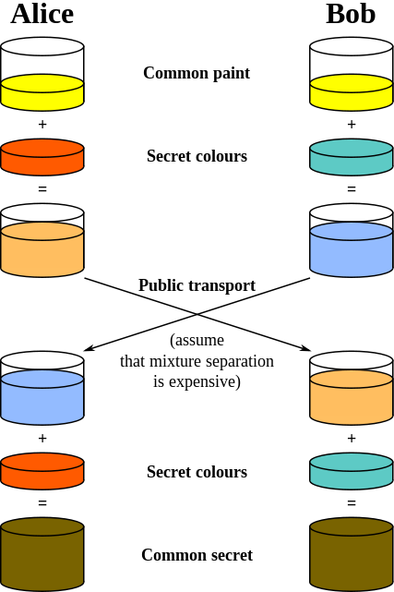
Diffie-Hellman by Analogy
A.J. Han Vinck, Introduction to public key cryptography, p. 16

Slide 67
Hash Functions
We saw before that one-way functions can let us do useful things like store capabilities
Basic idea: Hash(x) = y
Preimage resistance: It should be very difficult to take y and figure out x
Second preimage resistance: It should be very difficult to find another value z where Hash(z) = y
Collision resistance: It should be very difficult to find x1 and x2 such that Hash(x1) = Hash(x2)
Examples: MD5, SHA-1, SHA-3

Slide 68
Authentication
To prove you are who you say you are, we usually use one of three things:
Something you know
Something you have
Something you are

Slide 69
Passwords
"Something you know" – one of the simplest and oldest forms of authentication, and still ubiquitous
Generally easy to change
Very easy to implement, since you can just ask for a short string and compare it with the one you have stored

Slide 70
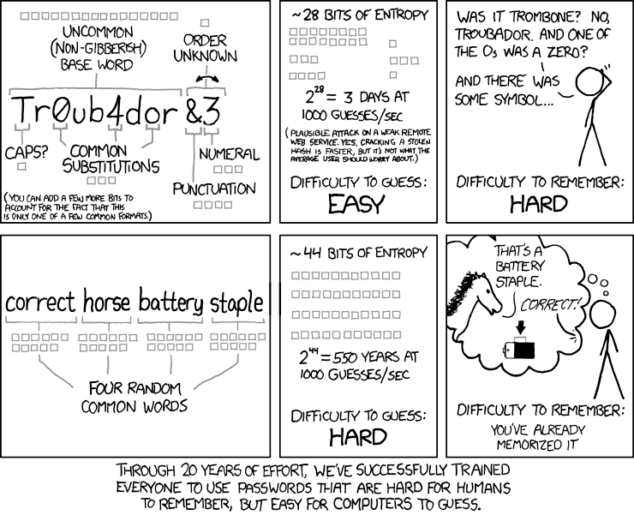

Slide 71
Password Storage
It's generally a bad idea to store passwords directly
If someone gets ahold of the password file, they can read all passwords
This is particularly bad since people tend to re-use their passwords in multiple places...

Slide 72
Password Storage
Instead, we use a cryptographic hash function on the password
We compute (for example):
SHA1("goodpassword") = 7e5ce399fbe3713ec7f6aae370448cdf990f0aaa
Then we only store 7e5ce399fbe3713ec7f6aae370448cdf990f0aaa
Now to check the password someone entered, we hash it and compare the hashes instead

Slide 73
How Passwords are Broken
Assuming they only have a file with password hashes, how can an attacker find out the original passwords?
Password hashes nowadays are broken primarily in two ways:
Precomputation: Spend a lot of time beforehand computing the hash of every possible password, then just look up each hash in your table
Dictionary Attacks: Guess the most common passwords (e.g. using a dictionary), hash them, and compare

Slide 74
Password Salts
To avoid precomputation attacks, we can use a salt
Instead of computing and storing Hash(Password), we instead:
Generate a random string (a salt)
Compute Hash(Salt+Password)
Store on disk Salt, Hash(Salt+Password)
Now to do a precomputation, you have to store not just the hash of every possible password (hard but doable) but the hash of every possible password+salt (way too much space)

Slide 75
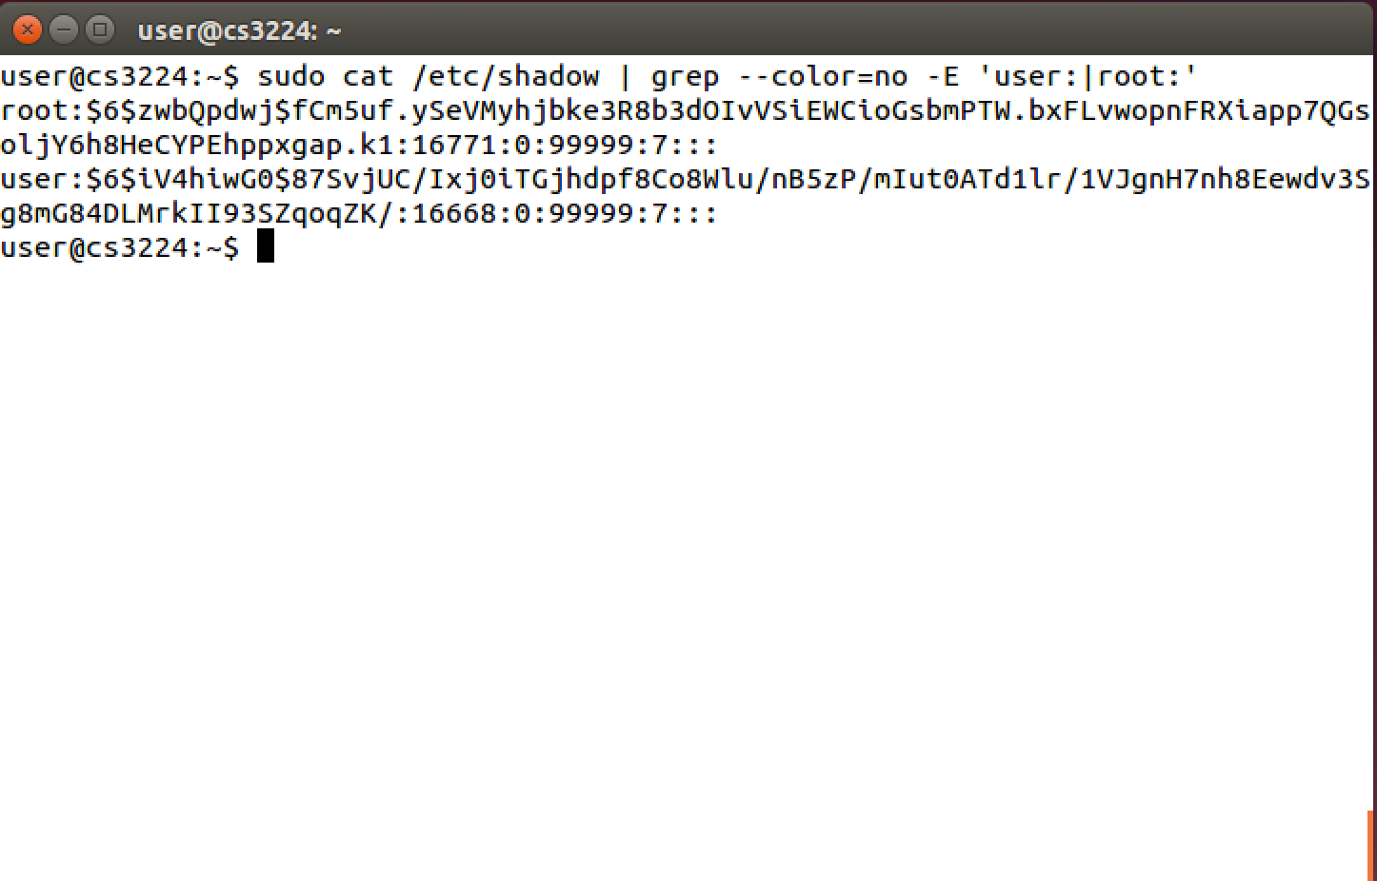
UNIX Password Files
UNIX password files are hashed and stored with salts:

Slide 76
Username: root Algorithm: 6 Salt: zwbQpdwj Hash: fCm5uf.ySeVMyhjbke3R8b3dOIvVSiEWCioGsbmPTW.bxFLvwopnFRXiapp7QGsoljY6h8HeCYPEhppxgap.k1
Username: user Algorithm: 6 Salt: iV4hiwG0 Hash: 87SvjUC/Ixj0iTGjhdpf8Co8Wlu/nB5zP/mIut0ATd1lr/1VJgnH7nh8Eewdv3Sg8mG84DLMrkII93SZqoqZK/

Slide 77
Time- and Memory-Hard Password Hashing
Cryptographic hash functions were developed to be fast
This is good for many uses of them, but bad for passwords: it lets an attacker try billions of passwords per second
To avoid this, people have developed hash algorithms that are deliberately very slow (and cannot be sped up)
One example is bcrypt
We may also want it to take a lot of memory
A newer algorithm called scrypt does this

Slide 78
One-Time Passwords
An alternative to having a single password is to use a different password every time
Even if an attacker eavesdrops on a connection and learns the password, it doesn't do them any good
A password list can be exchanged securely (e.g., banks sometimes send them in the mail)
Notes:
The most common is 12345
The other ones are “password”

Slide 79
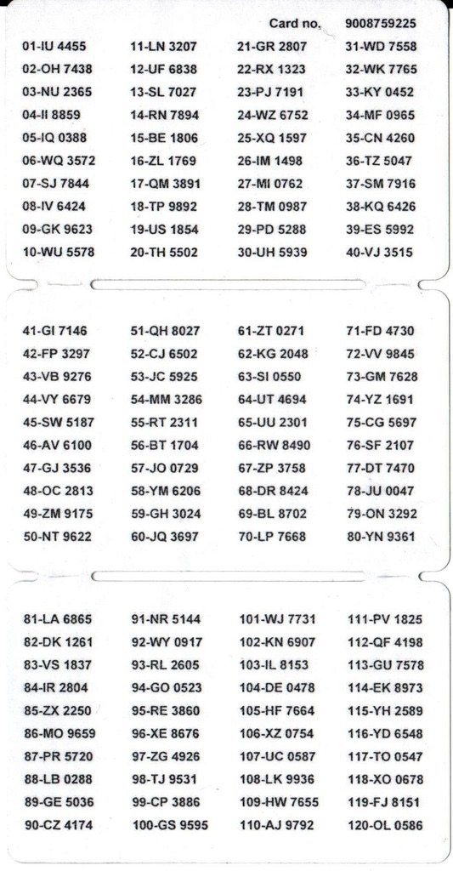
Nordea Bank one-time password list
Notes:
Swedish bank

Slide 80
Lamport Hash Chain
Instead of mailing out passwords each time, we can get many of the benefits using a hash chain
The idea is to use a one-way function to create a sequence of hashes
If you repeatedly apply a hash to some starting value, you get a sequence that is:
Easy to compute starting from the seed going forward
Hard to compute starting from a hash value and going backward

Slide 81
Lamport Hash Chain
Initially, user chooses a password p
Compute f^{k}(p) = f(f(f(...f(p)))) and store this value on the server
To log in, user computes and sends h = f^{k-1}(p)
Server checks that f(h) matches its stored value, and then replaces the current stored value with h

Slide 82
Challenge-Response
Another way to avoid sending a password directly over the network is challenge response authentication
The idea is that the server sends a challenge (a random value)
Client then uses their secret and the challenge to compute a response
Server can now verify that the response is the correct one for that challenge

Slide 83
Challenge-Response
One simple way to implement challenge response is to once again use a one-way function
Client and server each know some secret s (say, a password)
Server computes a random r and sends it to the client
Client computes f(r+s) and sends it to the server
Server can do the same computation to verify
Value sent over the network is useless to an attacker since the challenge (r) will not be reused

Slide 84
Authentication
To prove you are who you say you are, we usually use one of three things:
Something you know
Something you have
Something you are

Slide 85
Physical Tokens
Oldest examples: physical keys
Basically – something you physically possess that grants you access to something
There are lots of these now: ATM cards, smart cards, RFIDs, secure tokens, smartphones

Slide 86
Smart Cards
Credit card sized
Contain a chip that can do some simple cryptographic computations and stores a secret key
The reader can then ask the chip to do cryptographic operations without revealing the key to the reader

Slide 87
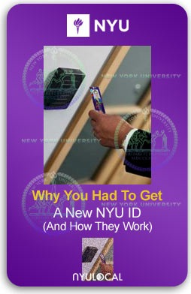
RFID Authentication
Radio communications can be used instead of direct contact
When you put the card near a reader, the reader actively probes
The card can collect energy from the incoming radio waves, compute a response, and send it back

Slide 88
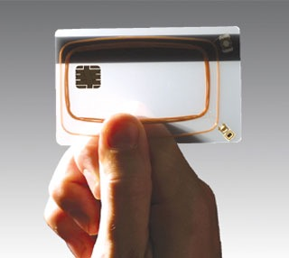
Inside an RFID

Slide 89
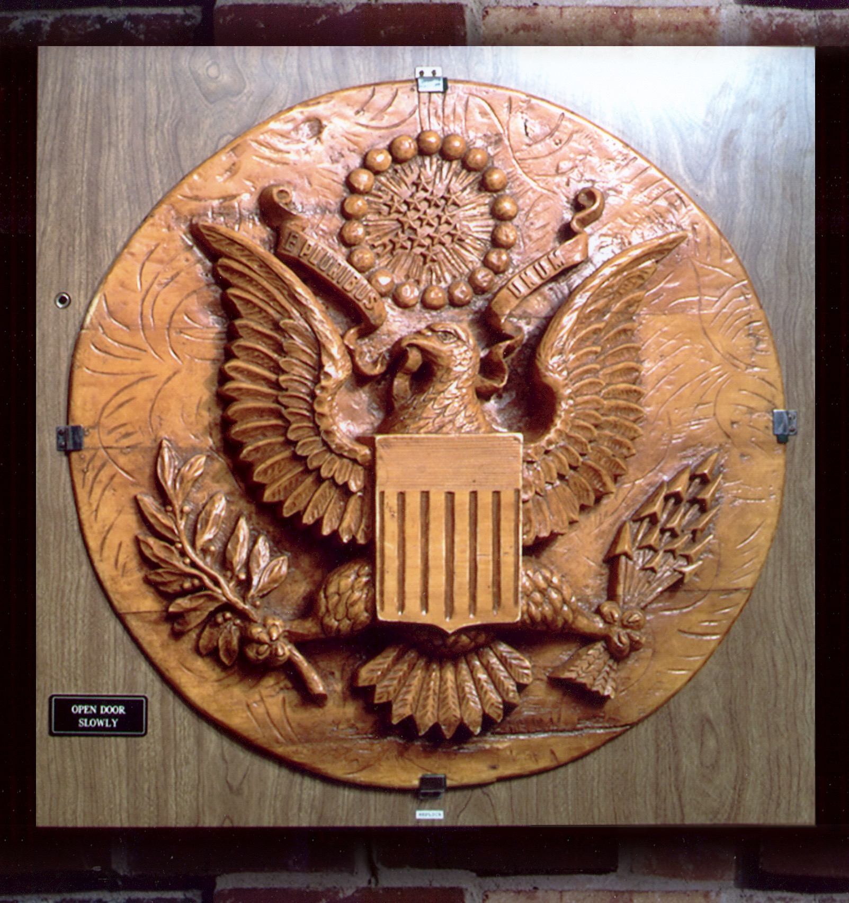
The Great Seal Bug
An early predecessor to RFID technology was the great seal bug
This was a carved wooden seal presented by the Soviets to the US in 1945
If radio waves at the right frequency were sent to the device, it activate the circuit and send sound back
Entirely passive listening device – very hard to detect!
Notes:
It had a drum inside.

Slide 90
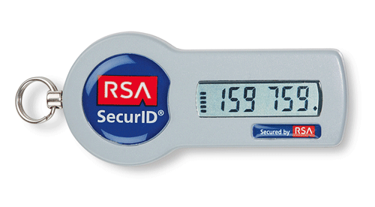
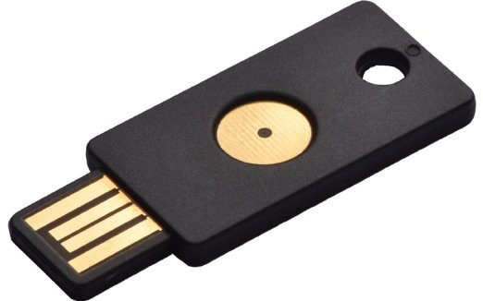
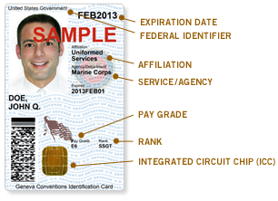
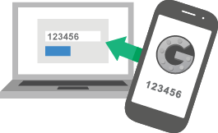
Physical Tokens

Slide 91
Authentication
To prove you are who you say you are, we usually use one of three things:
Something you know
Something you have
Something you are

Slide 92
Biometrics
Idea: measure something intrinsic to a person that is different for everyone
Things you can measure (partial list):
Fingerprints
Retina pattern
Voiceprint
Gait
Keystroke timing
Finger length
Face recognition
DNA?

Slide 93
Biometrics
Two phases: enrollment and verification
Enrollment consists of taking the measurements of a user and converting them into digital form
Often measurements are taken multiple times to account for measurement error and natural variation
At verification time, redo the measurement, and decide if it's close enough (will almost never be exactly the same)
Note the tradeoff here: risk of rejecting a valid user vs accepting an invalid user
Notes:
Decreasing False Positives

Slide 94
Biometric Downsides
Many biometric features are not very stable
Voiceprint may change if you get a cold
Gait may change if you twist your ankle
Some features may not be very acceptable to users
E.g., blood sample collection

Slide 95
Biometric Revocation Problem
The biggest problem with biometrics is that they are not revocable
If my password is stolen, I get a new password
If my fingerprints are stolen, ???

Slide 96
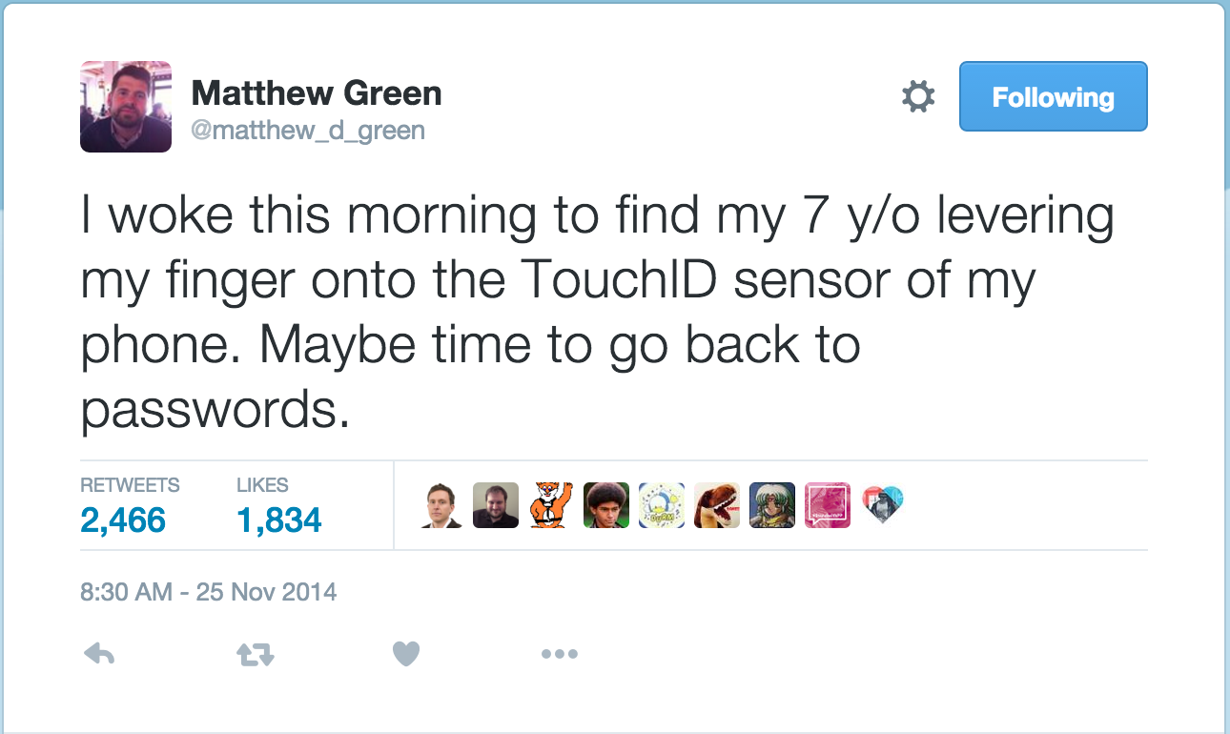

Slide 97
Security
Basics of Cryptography
Authentication
Software Security

Slide 98
Software Security
One final aspect to OS security is software security – identifying and preventing programming flaws that could let an attacker take control
Many of these are caused by the fact that languages currently in use are not memory safe – it is possible to write to data outside of program variables
A big offender here is C/C++

Slide 99
Stack Buffer Overflows
We saw one of these earlier in the semester
Recall the standard stack frame:
Local variables Saved frame pointer (optional) Return address
If we try to store too much data in a lock stack variable (e.g. a character array) we will overwrite the frame pointer and return address
When the ret instruction is executed, it will jump to somewhere controlled by user input

Slide 100
Classic Buffer Overflow
#include <stdio.h>
#include <string.h>
int main(int argc, char* argv[]) {
char buf[64];
strcpy(buf,argv[1]);
printf("Input:%s\n",buf);
return 0;
}

Slide 101
Operating System Defenses
OSes can be designed to make problems in user-level applications harder to exploit
These generally don't make attacks on software impossible, but they can make them much more difficult
This is something of an arms race – defenders come up with new mechanisms, attackers find ways around them

Slide 102
Stack Canaries / Cookies
Idea: put a special value in between local variables and the return address so that overflowing a local buffer can be detected
Upon entering the function, set a randomly-generated cookie value on the stack and store a backup copy elsewhere
Before executing a ret, check the stack cookie value against the backup and raise an error if it fails
Notes:
On by default:
VS
GCC
Clang

Slide 103
Address Space Layout Randomization
Exploiting a buffer overflow typically requires knowing about the precise layout of memory
For example, we may need to know where the stack is located, or where a certain library has been loaded
Thus, to make attackers' lives more difficult, we can place the program, stack, and libraries at random locations each time the program starts
Notes:
In XV6 the data always goes in the same address.
We can randomize the location of the stack

Slide 104
ASLR and Address Space
We can estimate the amount of randomness provided by ASLR by counting the number of possible locations to load things
On a 32-bit system, address space is not very large, so there are not very many ways to randomize
In 2004, researchers showed that on 32-bit systems, ASLR only has about 16 bits of entropy (65,536 possible values)
The correct location can be guessed in a matter of seconds by just trying each possibility

Slide 105
DEP / NX / W⊕X
Another defense is to try and make sure that even if an attacker can overflow a buffer and change the return address, they can't execute code
In the previous example, attacker code was placed into a stack buffer
So, simple solution: don't allow data to be executable!
Generally this requires hardware support
NX bit in x86 page protections
Notes:
Data Execution Prevention: MSFT
NX: Intel
W XOR X

Slide 106
Return-Oriented Programming
Despite DEP, attackers can still run code!
Instead of trying to execute their own code, attackers can change the return address to point to existing code in memory
By setting up values on the stack, they can bounce around executing tiny snippets of code ending in ret
Thus, by chaining these together, arbitrary computation can be performed – without executing anything marked as data

Slide 107
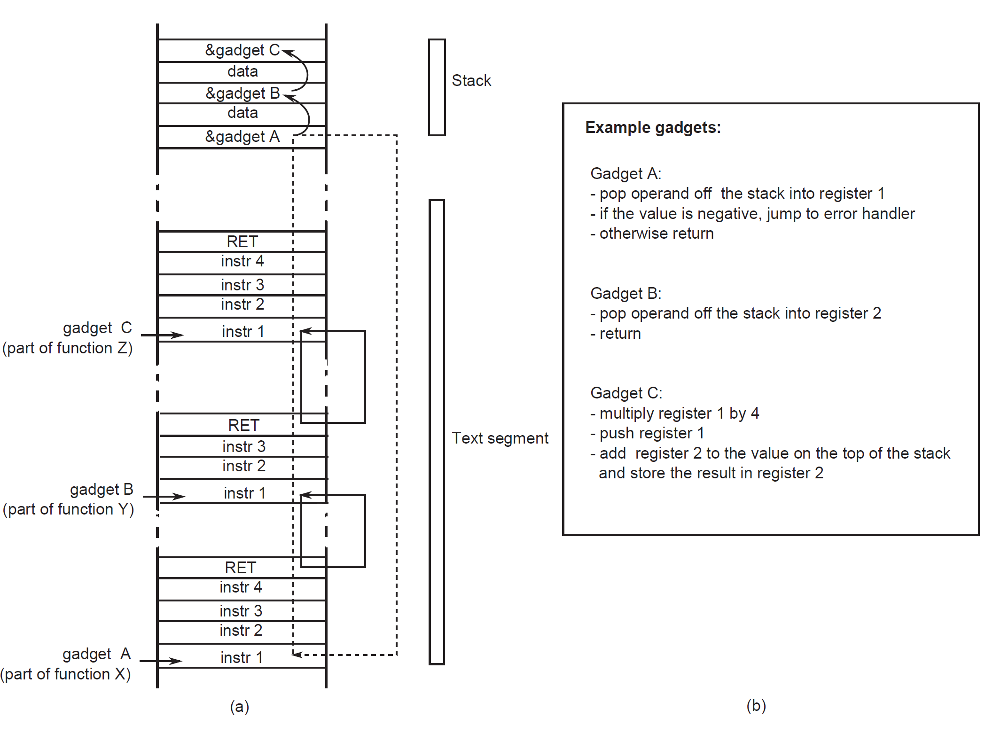

Slide 108
Dangling Pointers
An increasingly common and exploited class of vulnerability is the dangling pointer or use after free vulnerability
Scenario: programmer frees an object, but then continues to use the pointer afterward
Problem: new allocations may use the same space, placing a different object at the same location
If an attacker can manage to get his data placed into that freed space, can manipulate the program into executing his code

Slide 109
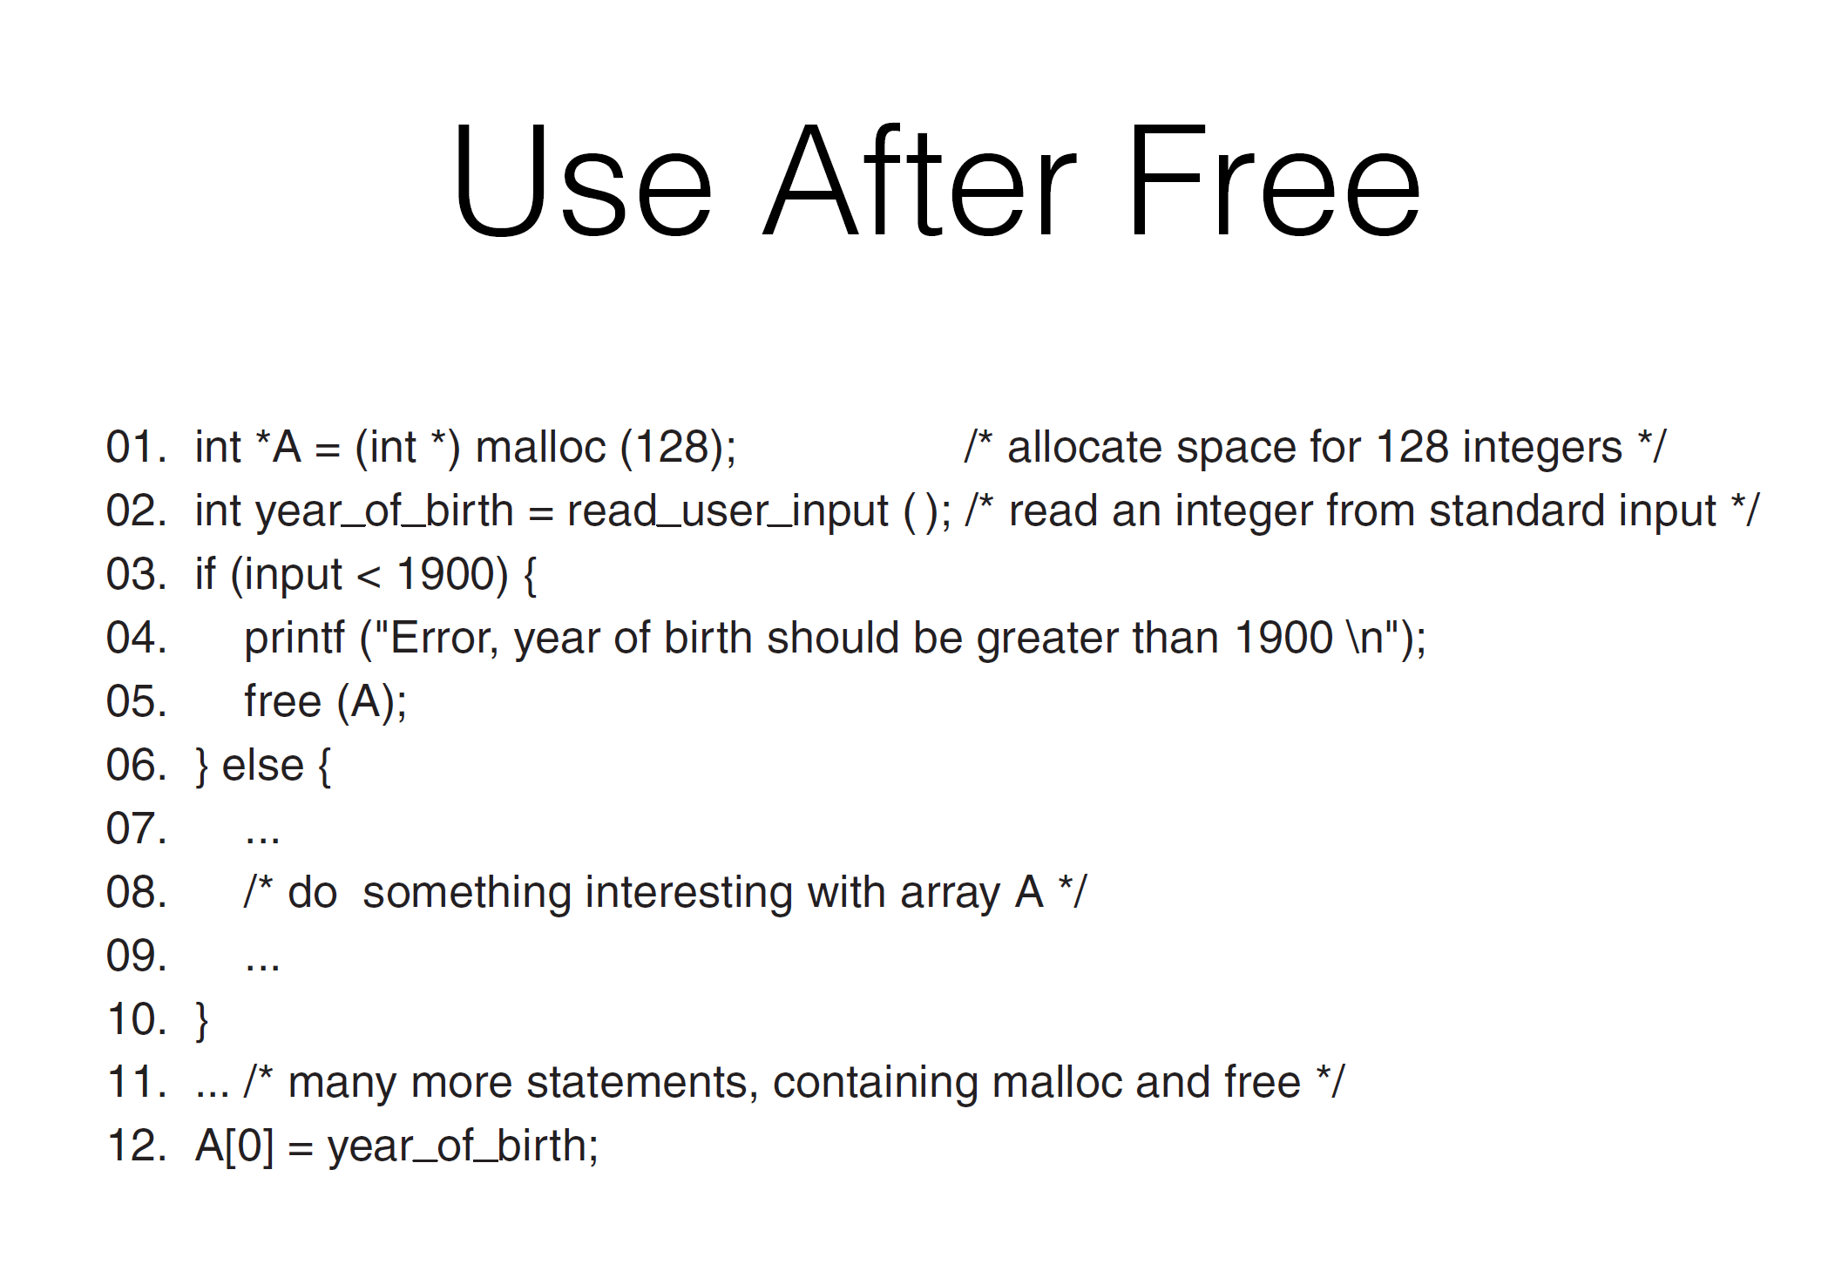
Use After Free

Slide 110
TOCTOU
One final class of attacks is a time of check to time of use attack
These arise any time you have a situation where
A security check on some object is made
The program does something with that object
An attacker can intervene in between 1 & 2 and cause it to operate on a different (attacker-controlled) object

Slide 111
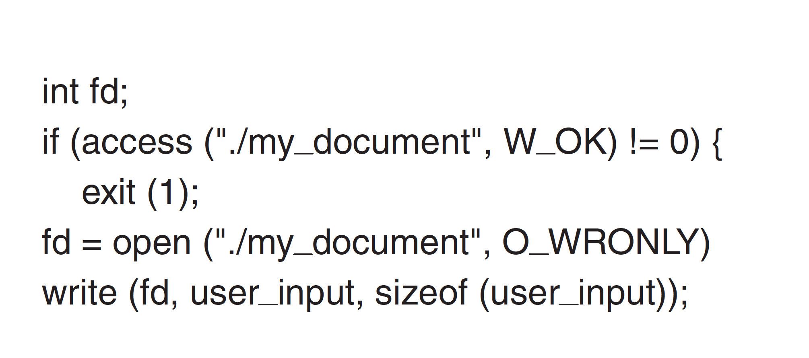
TOCTOU Example

Slide 112
TOCTOU Attack
To exploit this program, the attacker runs the program with a my_document he controls
After the access check is done, he deletes my_document and creates a symbolic link from my_document to some sensitive file
Getting the timing right here may be tricky!
The program now opens and writes to my_document, but that now results in writing to the sensitive file

Slide 113
Preventing TOCTOU
In general, the only way to prevent TOCTOU attacks is through careful API design
In this case, we want to make sure that the file cannot be changed between the access check and the call to open
One way to do this is to open the file and then perform access checks on the file descriptor (which can't be changed by the attacker) rather than the file (which can)

